Slide 1


ENGR 180 Summer DataFest Presentation
National Crime Index of 2022 within Merced County
Group 5
Professor: Madeline Brown
Date: May 25, 2022
Andrew Lara-Kane
5th Year CSE Major
Hao Dinh Mai
Fourth year Computer Science major

Slide 2
What Data Are We Using, and Why Is It Interesting To Us?
The data we use in our map is the US Crime Index for 2022, placing it over the Merced county area to see what kinds of crime are associated with what area. This includes personal, motor, property, and robbery levels of crime. The data is interesting to us because any person can be a victim of these sorts of crime. Knowing what kinds of crime are popular to what areas is good to know when you’re planning a trip so you can stay as safe as possible. It is also important for education, since everyone goes in with the mindset, “It’ll never happen to me!”. Understanding how many different kinds of crime are committed just this year alone in the area can be an eye-opener for safety.

Slide 3
Data Description
Merced County and Interstate Lines:
Outline of the county to focus in on local areas, instead of a broad and undefined area. Specific streets, buildings, and highway names/numbers are included for a better understanding of the location of some of these crimes.
US Crime Index 2022:
Color-coded dots are placed in specific areas to signify which crime was committed in that specific location. Teal is for property crime, yellow is for personal crime, red is for vehicle theft, and black is for robbery. We also placed a dissolved buffer so it can be more easily identified, since the map covers quite a large area.

Slide 4
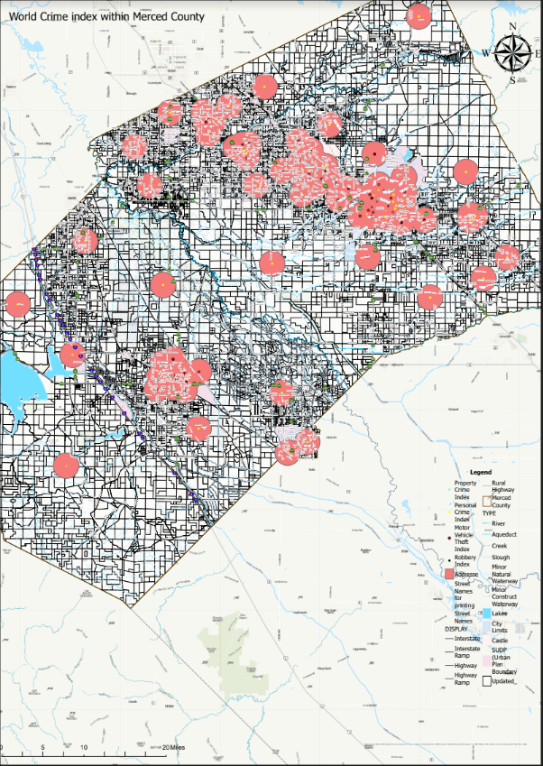
Geovisualization
This is the full map. It is quite zoomed out and not very discernable at first glance. This is where the buffers come in to assist. Since we are covering a really large area, to view it all at once, it helps to have an indicator as to the general area of these crimes. However, it only gives a very basic view and it only scratches the surface of what we are showing here. We will go over a focused, zoomed in version which gives a lot more detail.

Slide 5
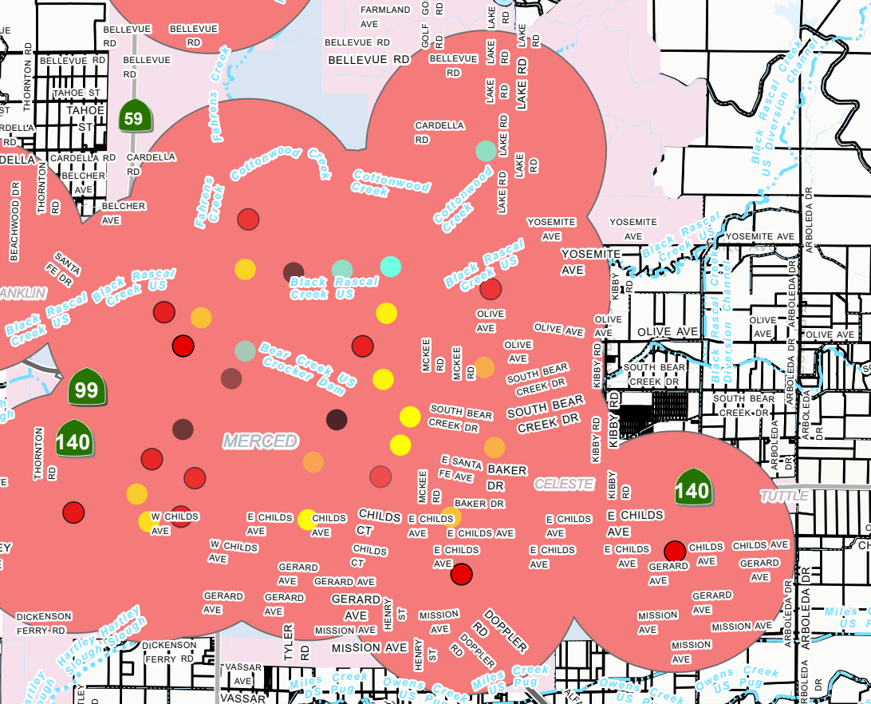
Geovisualization 2
Here is UC Merced, outside of the zone! The closest crime is a property-based crime at one of the houses on Lake Road.
In a way more zoomed in picture of downtown Merced, we can see the exact different kinds of crime that are being committed, and on what streets exactly. This is helpful when you want to understand the most common offenses, so you can bring or not bring anything necessary to avoid being a target. The buffers, while they do assist in a full view of the map, don’t help a lot here but do give a sense of the range that these crimes are committed in.

Slide 6
Data Integration
We scour Arcgis online resource to gather the data need to project the the desired outcome.
We first look for a layer map of merced county with various components such as street names, highways, and zones of operation ergo commercial, agriculture or development sections of the town.
We decided to choose this particular base map of Merced:
https://hub.arcgis.com/content/mcagov::merced-county-base-map-layers-public/about

Slide 7
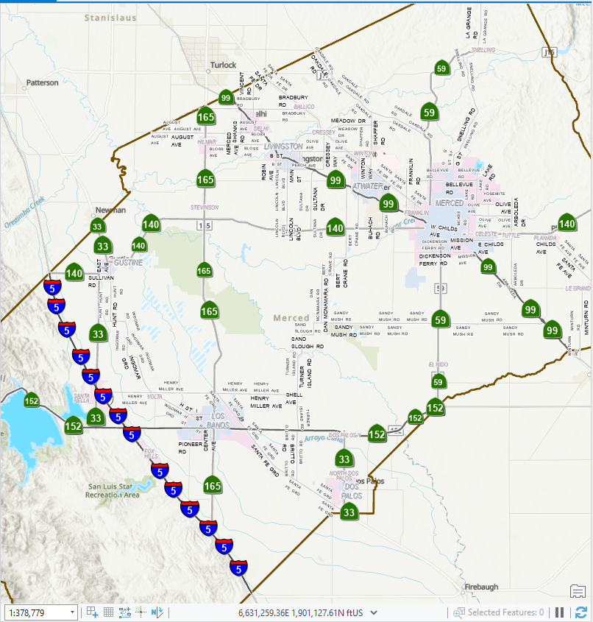

Slide 8
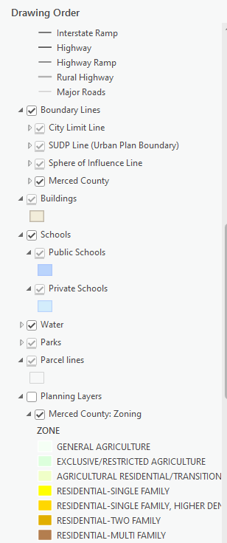

Slide 9
Data Integration continued…
We also searched for a parcel data for the city of Merced for the scenario of which we want to measure the distance in which the crime occurs with reference to the zone within the county, we shall use the metadata from the parcel data to perform such calculation.
Merced County General Plan Designation Map (arcgis.com)
B. As we integrate the parcel data, we will project the parcel to the base map - in this instance the projection method will be “1984 web mercator auxiliary sphere”. The purpose is to match the resolution for accurate data measurement and projection; this will lower error percentage.

Slide 10
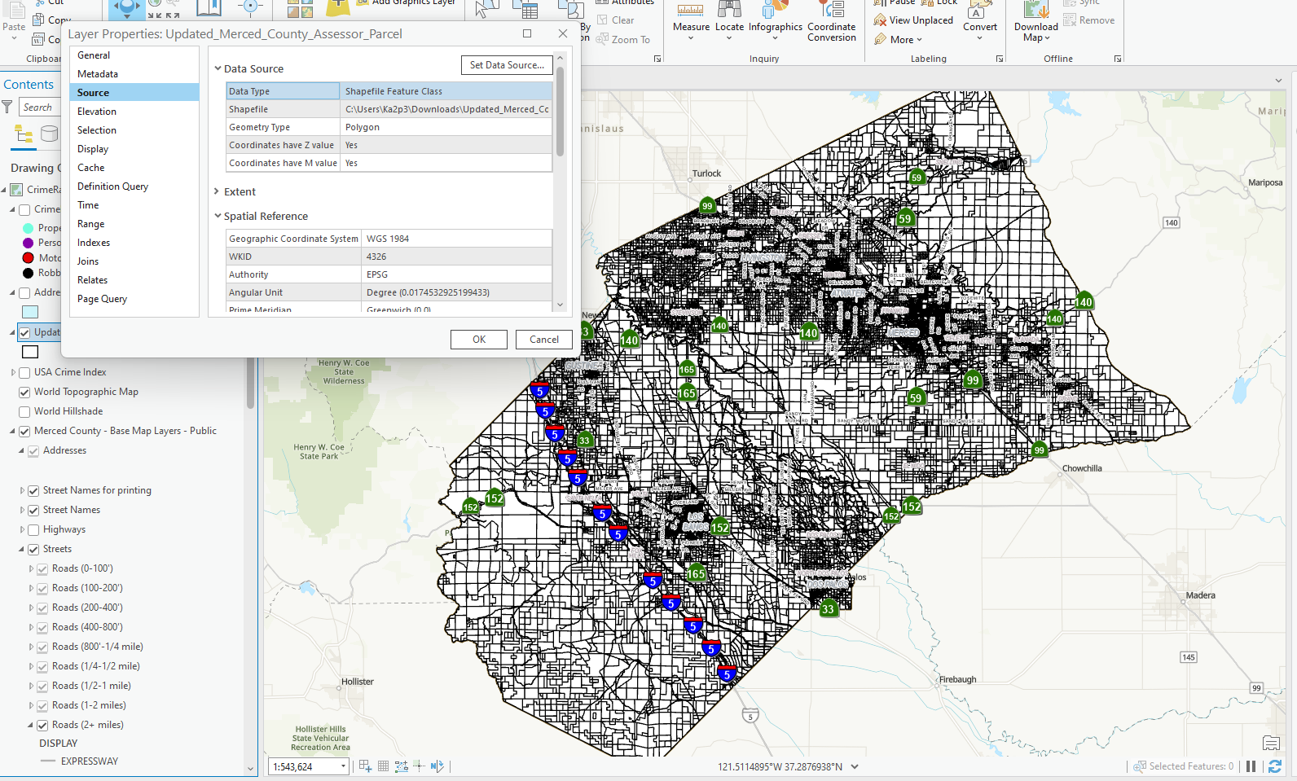

Slide 11
Importing Crime index file
We employ Arcgis online to the find a recent crime index of the united stated within the year of 2022:
https://ucmerced.maps.arcgis.com/home/item.html?id=738e2d35001d4268a8404033a76d989b
The objective is to use the clip operation to seclude the crime that occurs within Merced; we shall use clip spatial analysis to clip merced parcel data from the crime index. Deleting the crime index layer afterwards will display only the crime within the desire vicinity.

Slide 12
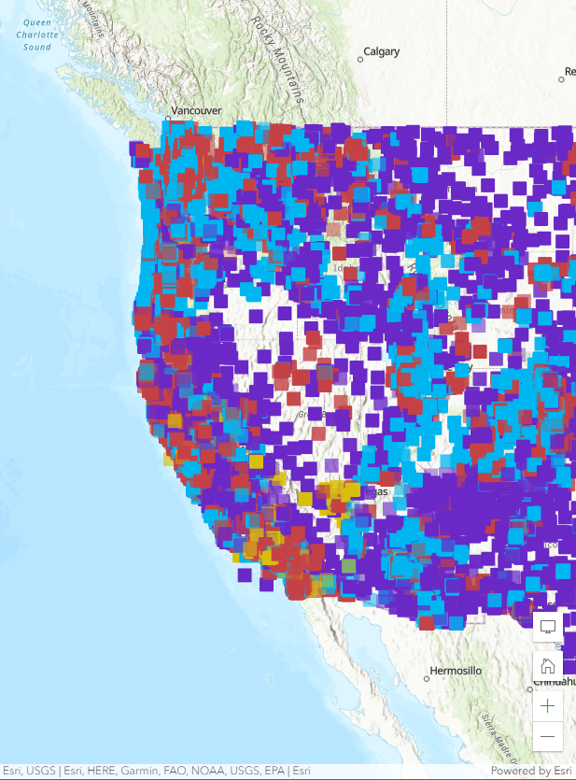

Slide 13
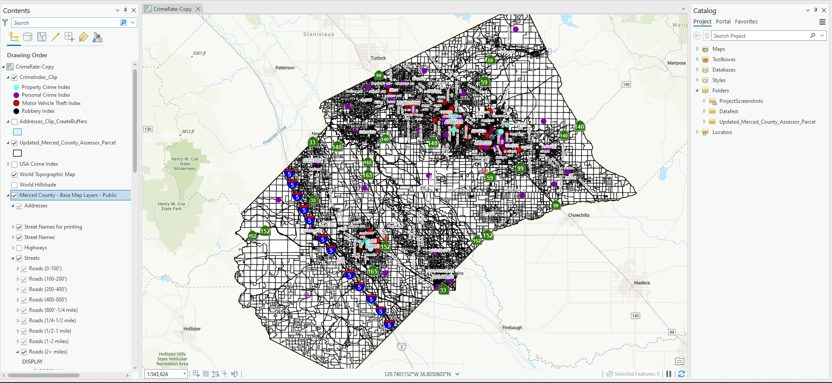
Clipped Operation Performed

Slide 14
Buffering
The last step is to buffer the location of the map to better identify the location in which crimes or clusters of crimes has occur within the city and what vicinity it is close by. This is done by employing the buffering spatial analysis tool and selecting the clipped layer output from the previous step and buffering the location of crime to 2 kilometer radius.

Slide 15
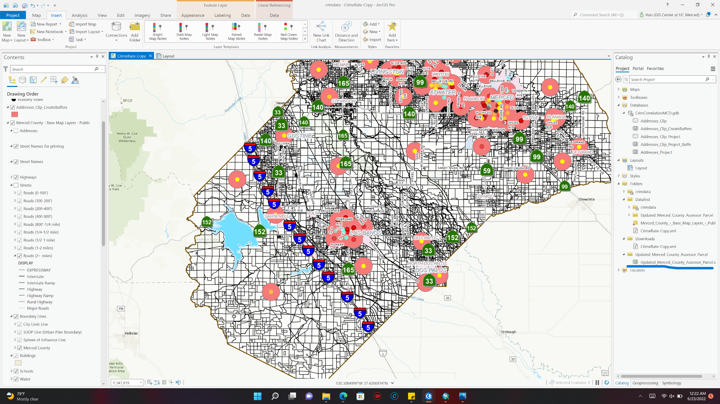

Slide 16
Conclusion
In conclusion, the importance of learning the frequency and types of crimes being committed in your own town is more important than we think. We all take the safety we have for granted, and that can lead to some unfortunate events that could negatively impact us for a long time or even the rest of our lives. Knowing about these things, even just keeping it as a little bit of knowledge that you don’t directly act on, can really help your daily life. Not only could it help with personal lives, but law enforcement could use it to keep tabs on certain hotspots and maybe stop the crimes before they are even committed.

Slide 17
References
https://hub.arcgis.com/content/mcagov::merced-county-base-map-layers-public/about
https://ucmerced.maps.arcgis.com/home/item.html?id=738e2d35001d4268a8404033a76d989b
https://mercedcounty.maps.arcgis.com/apps/webappviewer/index.html?id=31a7197f80cc4c729c0c559ca08150a5

